Slide 2
Becoming Azure KQL Ninja!

Slide 3














Introduction
BOOKS
PRATEEK SINGH
COURSE
TECH. WRITER FOR
Staff Software Engineer @ LinkedIn
/in/prateekkumarsingh
@singhprateik
/prateekkumarsingh
leanpub.com/b/books

Slide 4
Agenda
What is KQL? Why does it matter & its history
Azure Monitor and Common Data Platform
Demo 1 - KQL Primer to Advance* techniques
Demo 2 - Using KQL to query data in a Web Application
Thank you and Questions

Slide 5
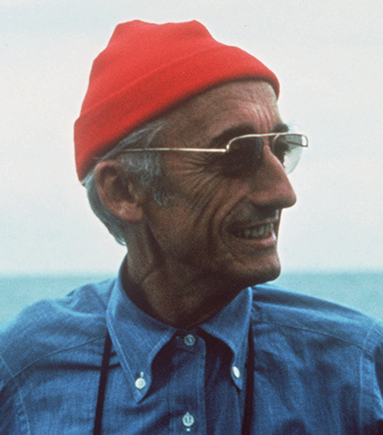



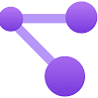
Introduction
WHAT?
KQL stands for Kusto Query Language
A powerful tool Data exploration (Big data analytics)
Fast, Pipeline-driven and Read-only query language
WHY?
Works well with MSFT ecosystem
Azure Data Explorer (Health care, Finance etc.)
Azure Monitor (Azure Log Analytics, Application Insights)
Azure Sentinel / Microsoft Defender for Cloud (Cyber Security)
Azure Resource Graph*
Versatile
Wide variety of supported data sources and types
Wide range of operators/functions for complex data analysis and transformation.
Profession / Skill
Cloud Architects / System Engineer
Cyber Security Specialist
Data Engineers
Software Engineers
Pattern discovery
Anomaly detection
Statistical modeling
'Kusto’ is named after Jacques Cousteau, as a reference to "exploring the ocean of data” Kusto was Internal project code name @MSFT

Slide 6

Purpose of Layout: Do this first, before you doanything. It’s vital to have the correct fonts installed before youstart.
History of KQL?
History of Azure KQL?
2021
Azure Data Explorer's next generation storage and query engine, "Kusto EngineV3", becomes GA
2019
Kusto becomes the backend big-data & analytics service for Application Insights Analytics
GA announcement @ MSFT Ignite conference
2016
2018
2014
Public Preview announcement @ Microsoft Ignite
Development of Kusto project begins in the MSFT Israeli R&D center

Slide 7
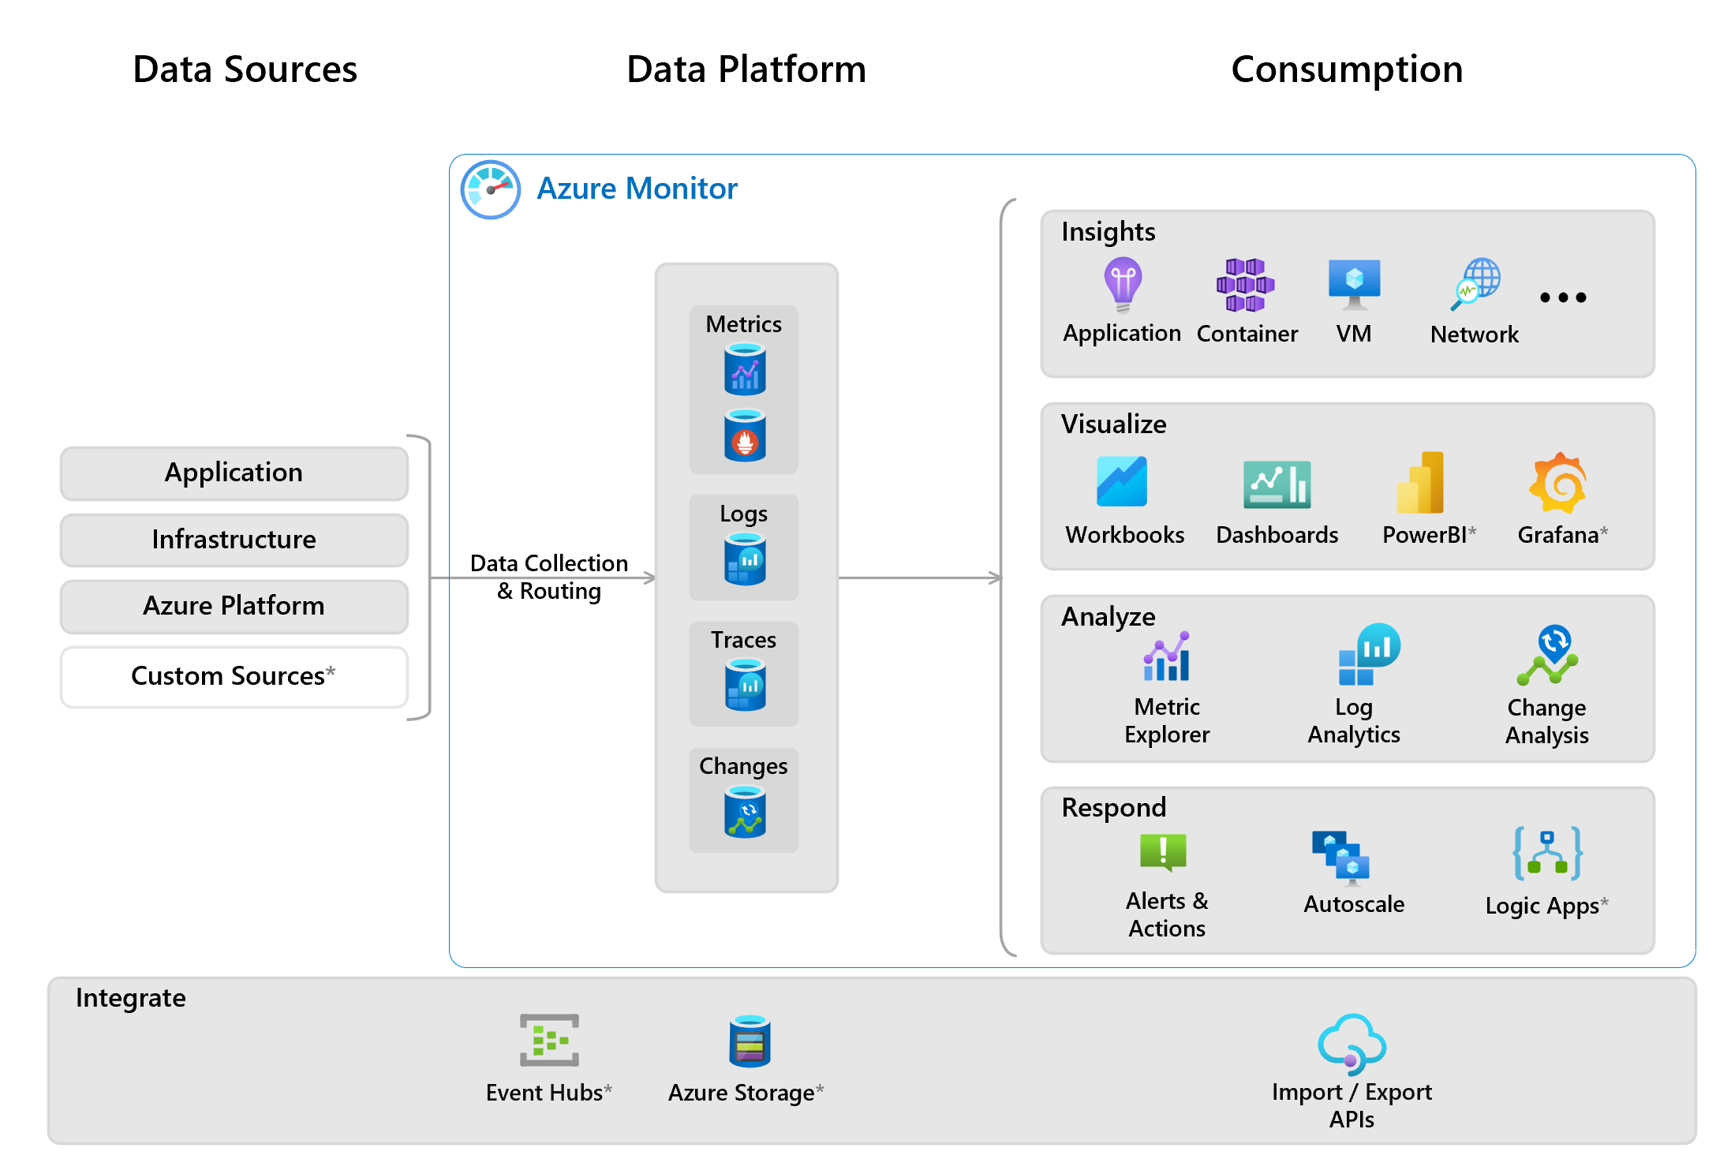
But where is my data?

Slide 8
DEMO - 1
KQL Primer to Advance* Techniques

Slide 9
DEMO - 2
Using KQL and Log Analytics in a Web Application

